Slide 1
Innovative Pediatric Study Designs
James Travis, FDA/CDER/OTS/OB/DBII

Slide 2
Disclaimer
This speech reflects the views of the author and should not be construed to represent FDA’s views or policies.

Slide 3
Problems with Pediatric Drug Development
It may be hard to recruit patients:
There may be fewer children with the disease
There are additional logistical challenges (parent’s schedule, missed days of school)
The study may be unpalatable to patients/parents (level of exposure to placebo, study assessment requirements)
We want to minimize the amount of information that needs to be directed collected in children.

Slide 4
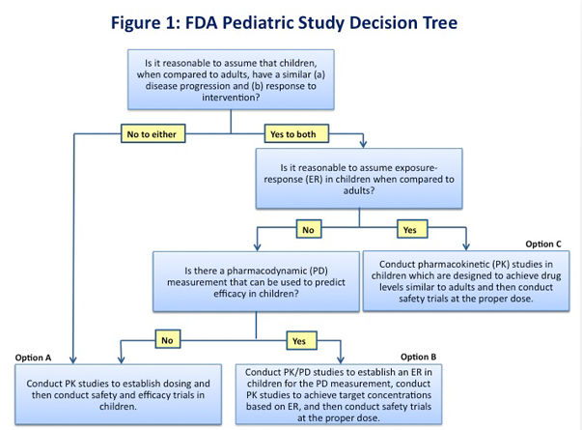
Extrapolation
https://www.fda.gov/science-research/pediatrics/pediatric-science-and-research-activities

Slide 5
Bayesian Borrowing
When we have data from the completed adult development programs that information will frequently have some degree of relevance to the pediatric population.
In some cases the relevance has been high enough that efficacy studies are judged to be unnecessary.
Otherwise, fully powered studies have been required.
Bayesian methods allow the borrowing of variable amounts of information.

Slide 6
Example – Belimumab (1/4)
Belimumab was approved for the treatment of Systemic Lupus Erythematosus (SLE) in 2011.
The FDA issued a post-marketing requirement for a safety, efficacy and pharmacokinetics study of belimumab in 100 pediatric patients.
The results of this study were submitted in 2018

Slide 7
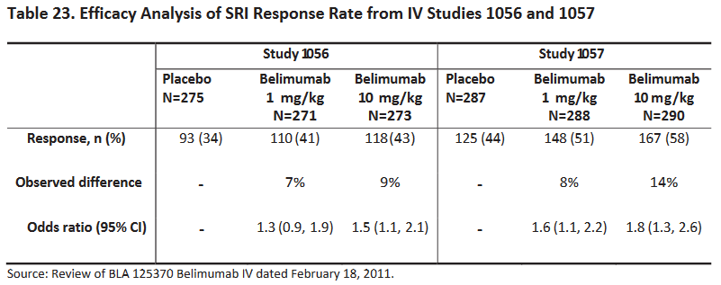
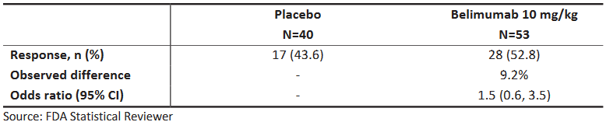
Example – Belimumab (2/4)
Adult Studies
Pediatric Study

Slide 8

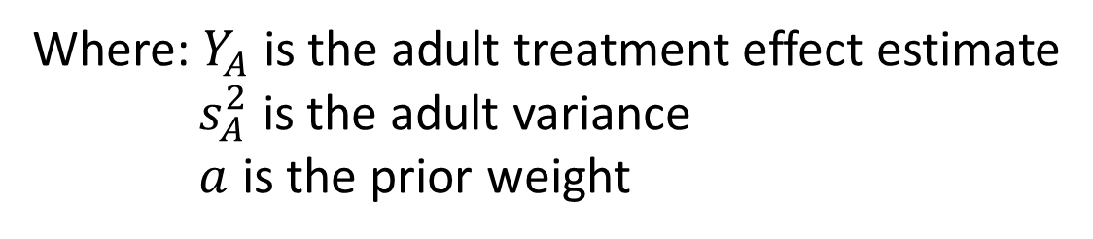
Example – Belimumab (3/4)
The FDA asked the company to conduct additional analyses using a Bayesian mixture prior approach which borrows information for the primary endpoint from adults.
Treatment effect prior:
Where: $Y_{A}$ is the adult treatment effect estimate
$s_{A}^{2}$ is the adult variance
$a$ is the prior weight

Slide 9
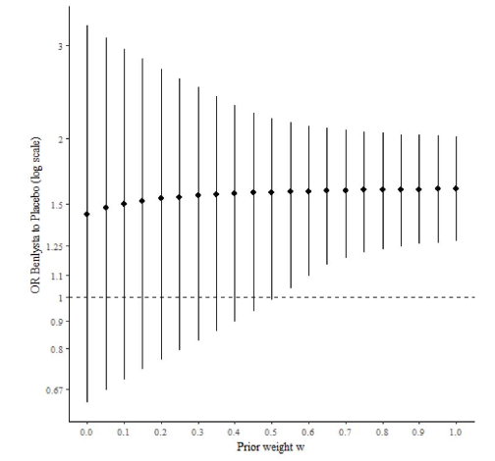
Example – Belimumab (4/4)
Interpretation: If we assume at least 55% prior weight, then we have at least a 97.5% posterior probability that belimumab is efficacious.
This analysis in conjunction with favorable results in analyses of secondary endpoints was sufficient for DPARP to expand the indication down to 5 years and older.

Slide 10
Platform Trials (1/2)
Platform trials study multiple treatments for the same disease under a single master protocol.
Typically requires cooperation between multiple sponsors.
The sharing of resources can reduce costs and improve efficiency.
Comes at a cost of increased complexity.

Slide 11
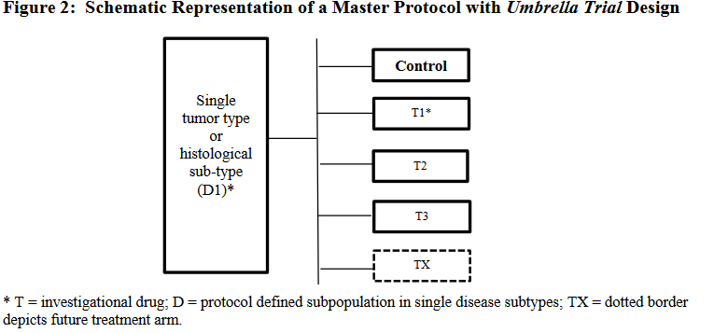
Platform Trials (2/2)
https://www.fda.gov/media/120721/download

Slide 12
Platform Trial – Examples
There are multiple examples in adults (iSPY2, BATTLE, NCI-MARCH, and Beat AML)
iMatrix studying treatments in pediatric and young adult patients with refractory/relapsed solid tumors.
Discussion exploring the potential for a platform trial for Duchenne muscular dystrophy (PPMD, I-ACT, and C-Path)

Slide 13
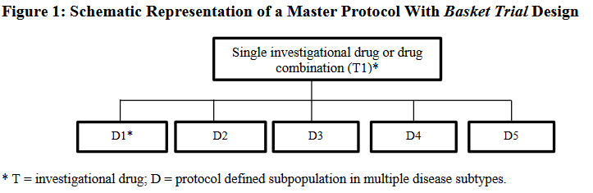
Basket Trials
https://www.fda.gov/media/120721/download

Slide 14
Basket Trial Example (1/3)
Larotrectinib was approved in 2018 for the treatment of adult and pediatric patients with solid tumors that:
have a neurotrophic receptor tyrosine kinase (NTRK) gene fusion without a known acquired resistance mutation
are metastatic or where surgical resection is likely to result in severe morbidity, and
have no satisfactory alternative treatments or that have progressed following treatment.

Slide 15
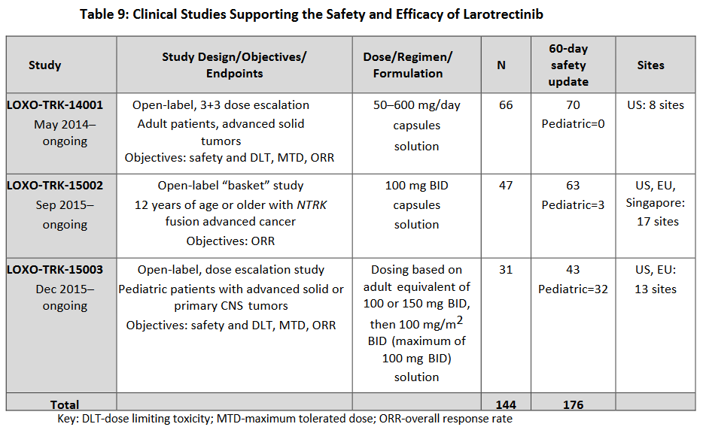
Basket Trial Example (2/3)

Slide 16
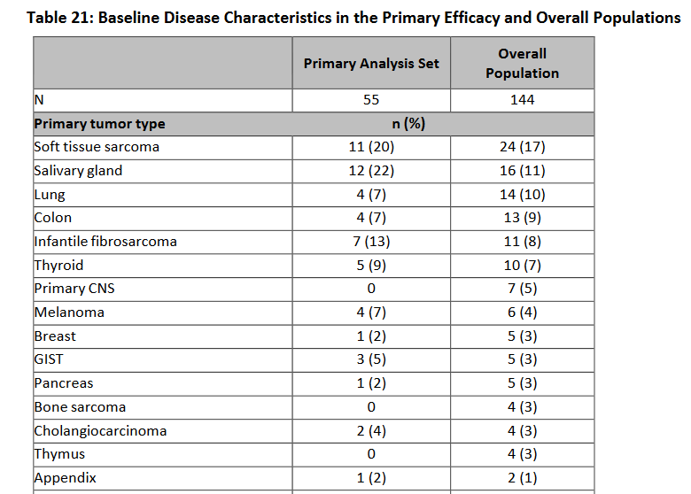
Basket Trial Example (3/3)

Slide 17
Adaptive Trial Design
This is a broad class of designs
Most advantageous when there is a long accrual time relative to the follow-up time which is common in many pediatric trials.
Can be implemented in the other discussed trial designs for additional efficiency gains.
https://www.fda.gov/media/78495/download

Slide 18
External Controls
Use of placebo is even more ethically problematic in pediatric studies, particularly where there is any risk of morbidity or mortality.
The rare diseases guidances discuss factors that need to be considered when external controls are used.
https://www.fda.gov/media/119757/download
https://www.fda.gov/media/122425/download

Slide 19
References
https://www.ascopost.com/issues/april-25-2017/accelerating-pediatric-drug-development-master-protocols-may-be-a-way-to-go/
https://www.fda.gov/media/120721/download
https://www.accessdata.fda.gov/drugsatfda_docs/nda/2018/210861Orig1s000_211710Orig1s000MultidisciplineR.pdf
https://www.fda.gov/media/127912/download

